Slide 1
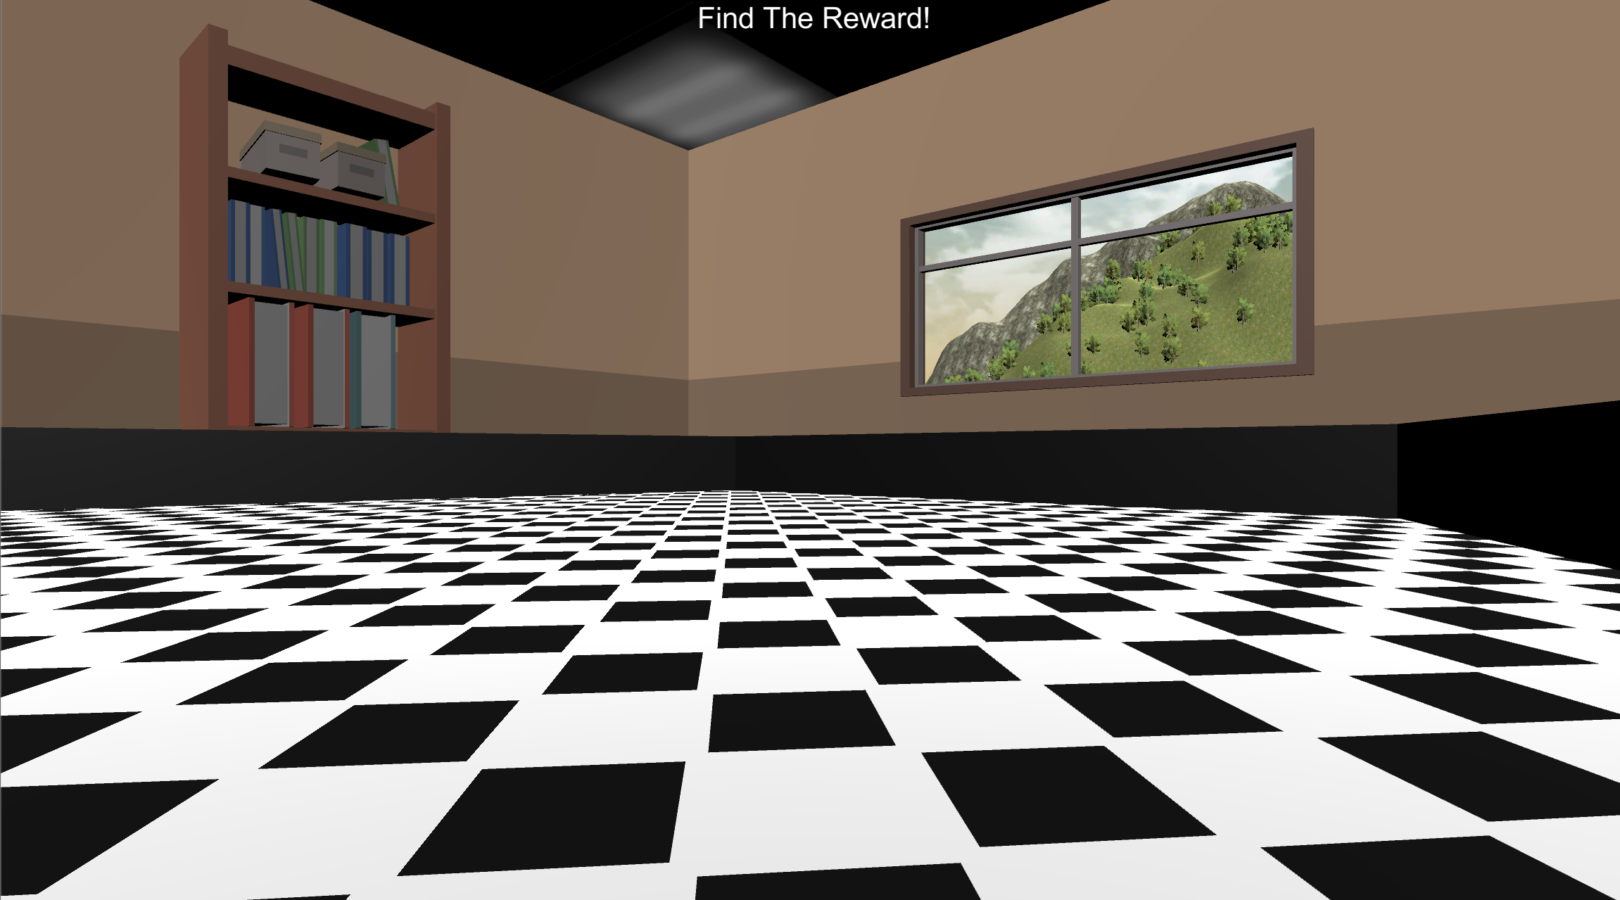
Welcome!
In this last session, your job is to navigate the environment pictured below and locate the invisible reward as fast as you can!

Slide 2
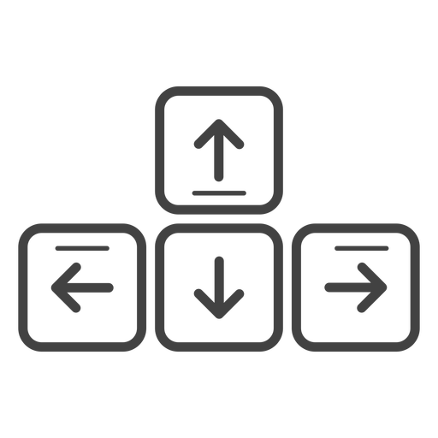
MOVEMENT CONTROLS
The controls are the same as previous sessions: use the Up-Arrow to move forward, and the left and right arrow-keys to rotate.
Move Forward
Rotate
Left
Rotate
Right

Slide 3

REWARD LOCATION ROUNDS
On each round, you will see the “LOCATE THE REWARD!” Screen and then you will be placed into the environment at a random location. The reward is invisible, but when you find it you will hear the reward sound and the round will end.
The goal on each round is to find the reward location as fast as possible!!

Slide 4


LOCATE THE REWARD!

Slide 5

Do you have any questions about this portion of the experiment? The experimenter will now leave the room and let you continue on your own. When this portion of the experiment is over you will be asked to notify the experimenter.
Spacebar
Place your right hand on the arrow keys and press the Spacebar with your left to continue!

Slide 6
Great Work! Please notify the experimenter that you have completed this portion of the experiment.

